Slide 1
AI Infrastructure and Architecture
Name : Surya ( roll no )
Topic : Fake News Classification (from Alternate Solution)

Slide 2
CONTENT
Introduction
Project Architecture
Data Collection
Data Preprocessing
Model Building
Model Evaluation
Visualization
Conclusion
References

Slide 3
Introduction To Fake News Classification
Objective:
In today's digital age, the proliferation of fake news poses a significant challenge. So, the objective of this project is to develop a model that can classify news articles as either fake or real.
By using local resources, we aim to build a robust classifier that can help in identifying misleading information.
Why Fake News Classification?
Relevance: Fake news impacts public opinion and decision-making.
Challenge: Distinguishing between legitimate and fake news is increasingly complex.
Goal: Enhance the accuracy and efficiency of news classification to improve information reliability.

Slide 4













ProJECT architecture :
Data Source
4. Model Evaluation
Accuracy Calculation
Web scrapping
ML Libraires
or
3. Model Building
or
Python libraries
Data Ingestion
Data stored
IDE
5. Visualization
1. Data Collection
2. Data Preprocessing

Slide 5
Data Source: Web Scrapped for the repository of news articles and Kaggle.
Data Acquisition: Downloading and storing the dataset locally.
Data Ingestion: Reading and loading the data into the local environment. Used Visual studio code and python script
Data Processing: Cleaning and preparing data using python libraries and function for analysis and model training.
Model Evaluation: Assessing the accuracy and effectiveness of the classification model.
Data Visualization: Creating graphs and charts to represent data and model performance using Power BI.

Slide 6
Data Collection
Choose Dataset Source: Selected a reliable source for the dataset, such as Kaggle as well as scrapped data using beautiful soup python library from news platform such as CNN and BCC .
Data download : Obtain the dataset in a format suitable for analysis (e.g., CSV, JSON) from Kaggle
Store Locally: Save the dataset to a local directory for easy access and processing.
Verify Data Integrity: Ensure the dataset is complete and correctly formatted by inspecting a sample of the data.
Local File System: For storing and managing the dataset.
Python Libraries: Pandas for reading and handling the data.

Slide 7
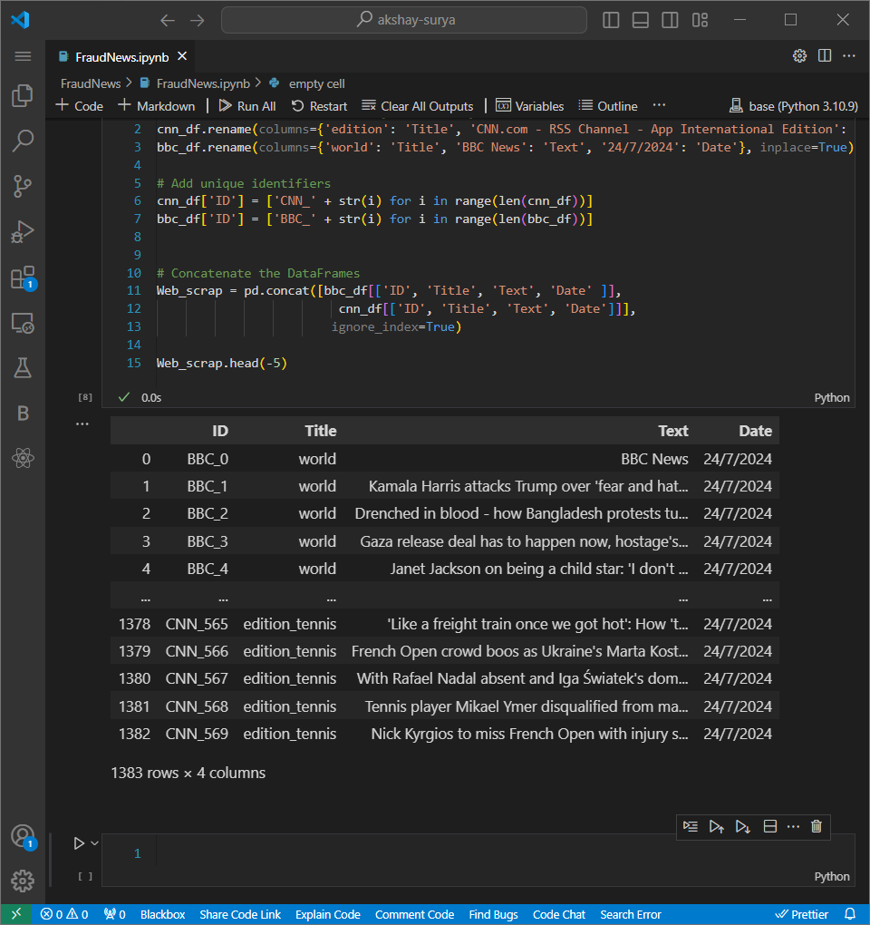
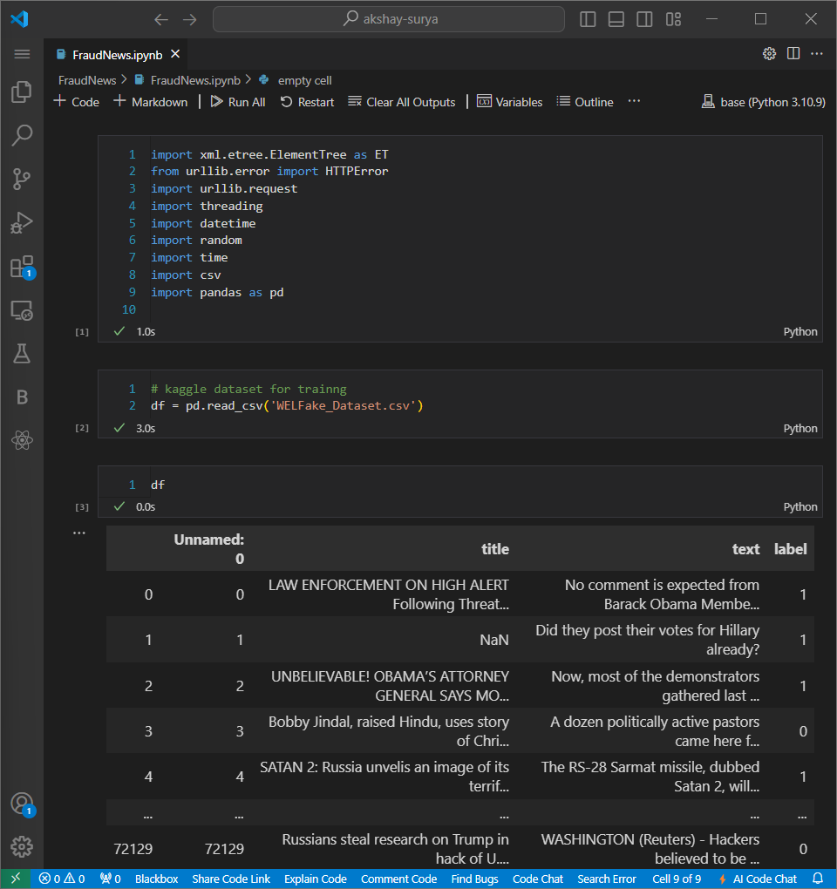
Web scrapped data
Kaggle data

Slide 8
Data pREProcessing
Prepared the dataset for model training by cleaning and transforming the data to ensure accurate and reliable results.
Steps:
Load Data: Import the dataset from a local file into a Data Frame using pandas for analysis.
Handle Missing Values: Identify and address missing or incomplete data by either removing or imputing values to maintain dataset integrity.
Text Cleaning: Process text data by removing punctuation, converting text to lowercase, tokenizing, and removing stopwords using libraries like NLTK.

Slide 9
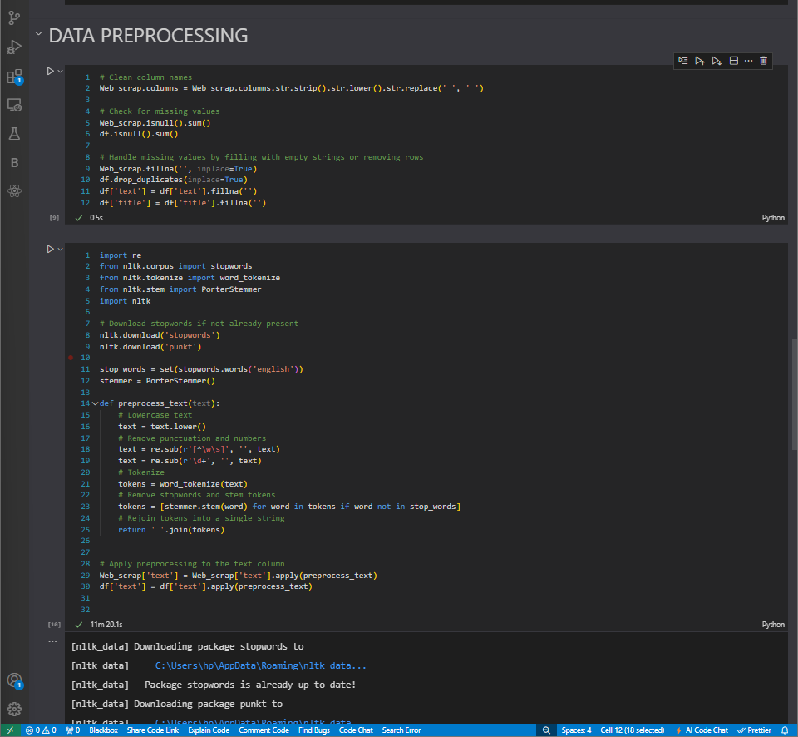
3. Feature Extraction: Convert text into numerical features using techniques such as TF-IDF Vectorization to make it suitable for machine learning algorithms.
4. Data Splitting: Divide the dataset into training and testing sets to train the model and evaluate its performance effectively.

Slide 10
MODEL BUILDING
Develop and train a machine learning model to classify news articles as fake or real based on the preprocessed data.
Steps:
Select Model: Chose a suitable classification algorithm, i.e. Logistic Regression,
Train Model: Use the training dataset to train the model and optimize its parameters for better performance.
Evaluate Model: Test the model on the testing dataset and assess its performance using metrics such as accuracy, precision, recall, and F1 score.

Slide 11
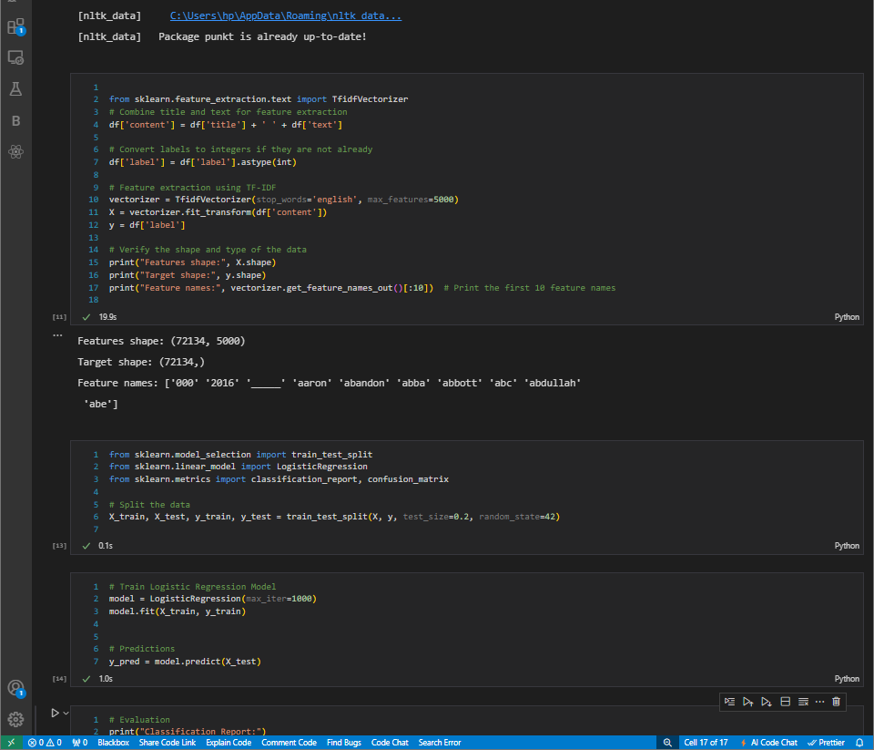
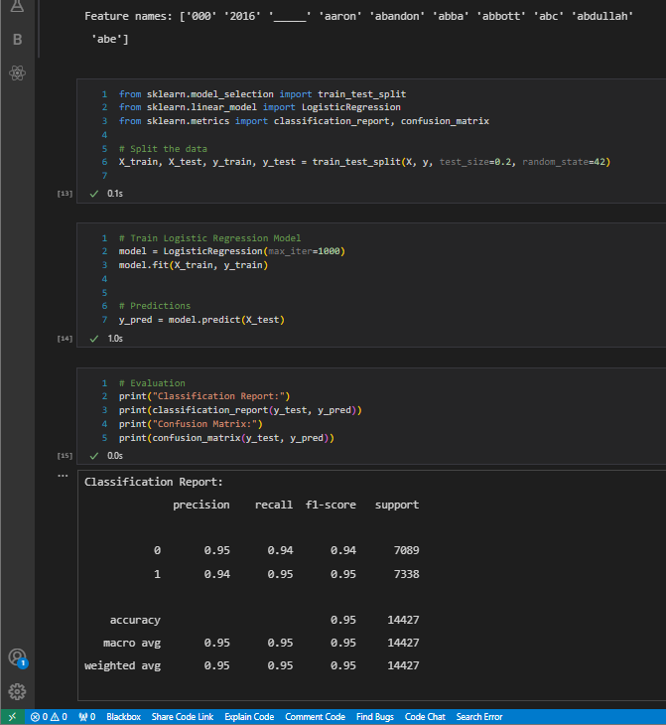

Slide 12
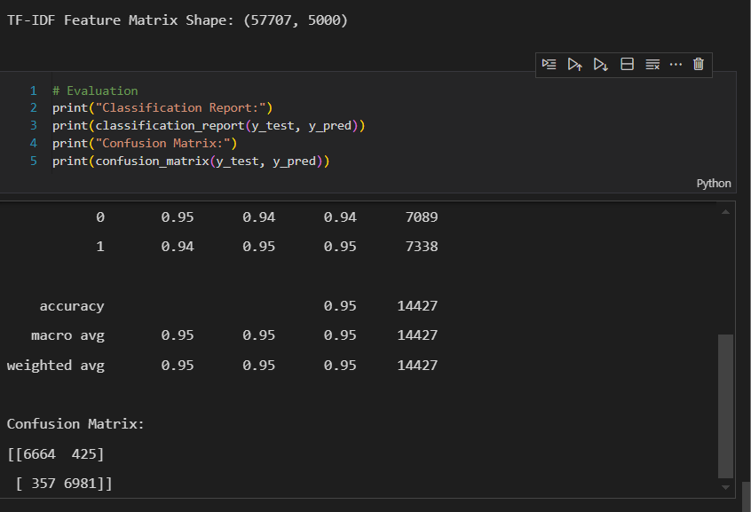
MODEL EVALUATION
Below results shows that the model is performing well in identifying both fake and real news articles with balanced performance.
Metric | Measurement
Precision | 0.95
Recall | 0.95
F1-score | 0.95
Challenges :
Data Quality and Consistency: Ensuring the quality and consistency of the dataset was a challenge, as the presence of missing values and duplicates required extensive preprocessing to prepare the data for training.
Textual Data Complexity: Handling the inherent complexity and variability in textual data, including different writing styles, tones, and contexts, posed a significant challenge in feature extraction and model training.

Slide 13
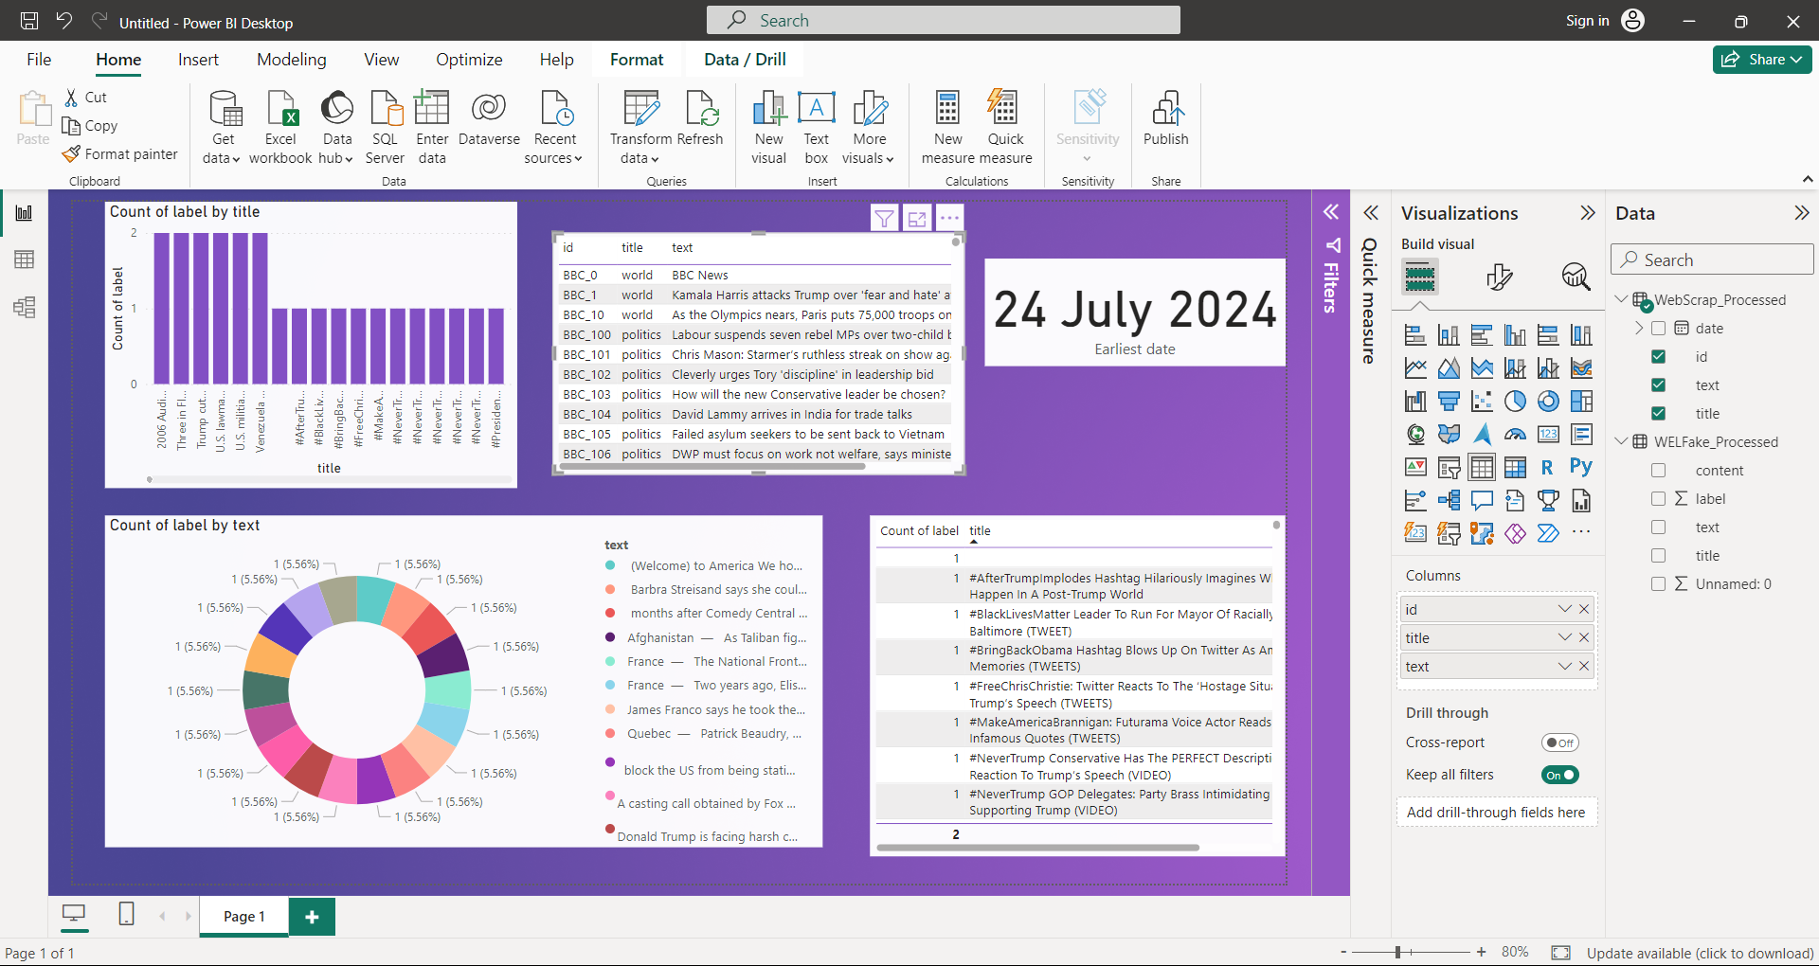
MODEL VISUALIZATION

Slide 14
CONCLUSION & FUTURE WORK
The logistic regression model successfully distinguishes between fake and real news articles with high accuracy, demonstrating its effectiveness for this task.
The model achieved an accuracy of 95%, with strong precision, recall, and F1-scores, indicating a balanced performance in predicting both fake and real news.
Explore more sophisticated machine learning algorithms, such as deep learning models (e.g., LSTM, BERT), to potentially improve detection accuracy and handle more complex language patterns.
Implement the model in a real-time system to monitor and classify news articles as they are published, providing immediate insights and flagging potential misinformation.

Slide 15
REFERENCES
Github Link :
Kaggle's WELFake Dataset: Bhatt, R. (2020). WELFake: A dataset for fake news detection. Kaggle. https://www.kaggle.com/datasets/saurabhshahane/fake-news-classification
CNN. (2024). CNN RSS Feeds. Retrieved from https://rss.cnn.com/rss/edition.rss
BBC. (2024). BBC News RSS Feeds. Retrieved from http://feeds.bbci.co.uk/news/rss.xml

Slide 16
Thank You

